Slide 1
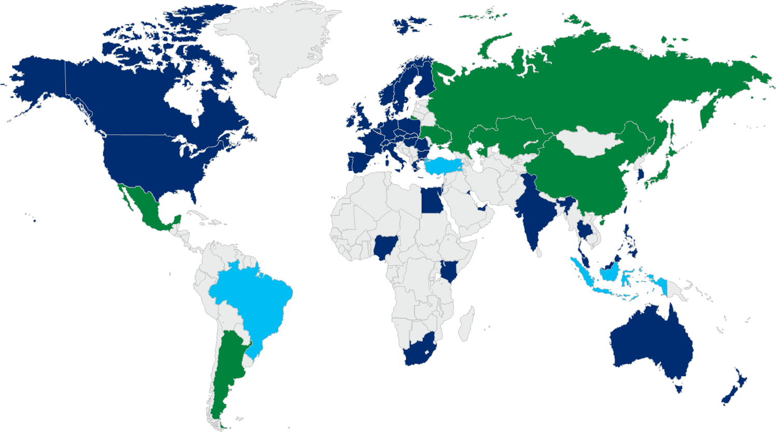
Citi Virtual Card Accounts – Continued Global Expansion
Citi plans to continue expanding VCA’s capabilities into new markets by leveraging our industry-leading global self-issuance platform
VCA Local
Currency Footprint*
Current
Planned–Implementing 2016*
Planned–Current Pipeline*
North America
EMEA
Asia Pacific
United States
Canada*
Austria
Belgium
Bulgaria
Czech Republic
Denmark
Egypt
Finland
France
Germany
Greece
Hungary
Ireland
Israel
Italy
Kazakhstan
Kenya
Kuwait
Luxembourg
Netherlands
Nigeria
Norway
Poland
Portugal
Romania
Russia
Slovakia
South Africa
Spain
Sweden
Switzerland
Turkey
UAE
United Kingdom
Ukraine
Australia
China
Hong Kong
India
Indonesia
Japan
Korea
Malaysia*
New Zealand
Philippines
Singapore*
Taiwan (Intl)**
Thailand
Latin America
Argentina
Brazil
Mexico
Current VCA local issuance footprint, as of November 2015
*Local regulatory restrictions may limit VCA use to certain types of organizations and/or use cases
**Taiwan Dollar (TWD) is available for international transactions only. Timing of in-country TWD is pending

